Slide 1



Philadelphia
LEGAL UPDATE

Slide 2
New Philadelphia Rental Laws
Rental Application Fees for background/credit checks are capped at $50 or their actual cost, whichever is lower.
New option for Tenant to pay the portion of security deposit that exceeds one month’s rent in 3 installments.
Philadelphia
ONLY

Slide 3
Rental Laws in Effect Dec. 2, 2025
In June 2025, Bill No. 250044-A and Bill No. 250045 were passed by the Council, signed by the Mayor on Sept. 3, 2025, effective as of December 2, 2025.
Updates The Philadelphia Code, Chapter 9-800 LANDLORD AND TENANT:
  The Security Deposit rules under Unfair Rental Practices §9-804(4) and
  Rental Application Fees under § 9-813
  Definitions under § 9-802

Slide 4
§ 9-813. Rental Application Fees.
When screening one or more individuals for tenancy:
No landlord, owner, real estate broker or agent, property manager, employee or agent thereof, shall demand or accept any fee from, or on behalf of, a prospective tenant other than a fee for conducting background check and/or credit check subject to limitations:
  Total shall not exceed actual cost or $50, whichever is less.
  In no case can any fee be charged for a credit/background check that is not performed.

Slide 5
Additional Limitations
Landlord cannot charge a prospective tenant more than one fee in any 12-month period for application at any premises owned by landlord.
“Hard pull” credit checks are not allowed.
Copy of Background Check and/or Credit Check must be provided to the prospective tenant.
Compliance with requirements of Fair Credit Reporting Act 15 U.S.C. § 1681 et seq. required (including adverse action notice).

Slide 6
§ 9-804. Unfair Rental Practices.
(4) Security Deposits
Landlord, owner, agent, other person operating or managing, is restricted to the collection limits under PA Law: 68 P.S. § 250.511a.
Where security deposit is one month’s rent or less, the full deposit may be collected as a lump sum.
If the security deposit for the first year exceeds one month’s rent, the security deposit payment may be accepted either:
  As a lump sum; or
  In installments with one month’s rent as lump sum and remainder in three (3) equal payments due once a month starting after the first month of tenancy.
  Amount charged must be the same for either choice.

Slide 7
Additional Information
Landlord prohibited from unlawfully retaining any portion of the security deposit.
The installment plan provisions do no apply to an owner, landlord, agent, property manager with 2 or fewer rental units.
  Ownership is aggregated across entities (to avoid circumvention).
Violation may subject owner, landlord, agent, property manager to actual damages, or statutory damages of one month’s rent. The court may also award reasonable attorney’s fees and costs to the person aggrieved.

Slide 8
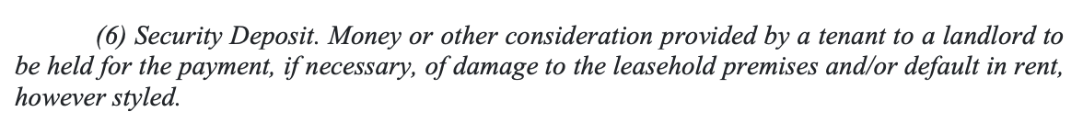
§ 9-802. Definitions. (added)
PA law applies: 68 P.S. § 250.511a:
No landlord may require a sum in excess of two months’ rent to be deposited in escrow as a security deposit.

Slide 9
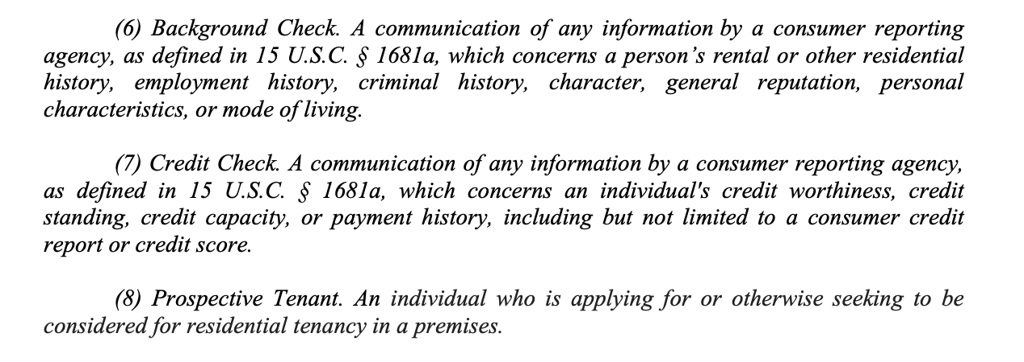
§ 9-802. Definitions.

Slide 10
The Takeaways:
Landlords may charge a fee for background check or credit check, that fee cannot exceed the actual cost, or a total of $50 – whichever is less.
Background check or credit check fees may only be charged if the check is conducted and a landlord may only charge the applicant once within 12-month period.
Applicants must be provided with a copy and compliance with Fair Credit Reporting Act required.
Cannot charge any more than state law allows for security deposit.
When the security deposit is equal to one month’s rent or less, it may be collected in one lump sum.
If the deposit exceeds one month’s rent, the tenant must be offered a choice: pay the full amount upfront or pay installments of one month at move-in and the remainder in three equal monthly payments starting in month 2 or later. Total amount must be the same with either choice.

